Slide 1
C H A P T E R
7
DATA MODELING AND ANALYSIS
Notes:
Chapter 7 - Data Modeling and Analysis
This repository of slides is intended to support the named chapter. The slide repository should be used as follows:
Copy the file to a unique name for your course and unit.
Edit the file by deleting those slides you don’t want to cover, editing other slides as appropriate to your course, and adding slides as desired.
Print the slides to produce transparency masters or print directly to film or present the slides using a computer image projector.
Each slide includes instructor notes. To view those notes in PowerPoint, click left on the View Menu; then click left on Notes View sub-menu. You may need to scroll down to see the instructor notes.
The instructor notes are also available in hard copy as the Instructor Guide to Accompany Systems Analysis and Design Methods, 5/ed.

Slide 2
Chapter Seven Data Modeling and Analysis
Define systems modeling and differentiate between logical and physical system models.
Define data modeling and explain its benefits.
Recognize and understand the basic concepts and constructs of a data model.
Read and interpret an entity relationship data model.
Explain when data models are constructed during a project and where the models are stored.
Discover entities and relationships.
Construct an entity-relationship context diagram.
Discover or invent keys for entities and construct a key-based diagram.
Construct a fully attributed entity relationship diagram and describe all data structures and attributes to the repository or encyclopedia.
Normalize a logical data model to remove impurities that can make a database unstable, inflexible, and nonscalable.
Describe a useful tool for mapping data requirements to business operating locations.
Notes:
Chapter 7 - Data Modeling and Analysis
No additional notes

Slide 3
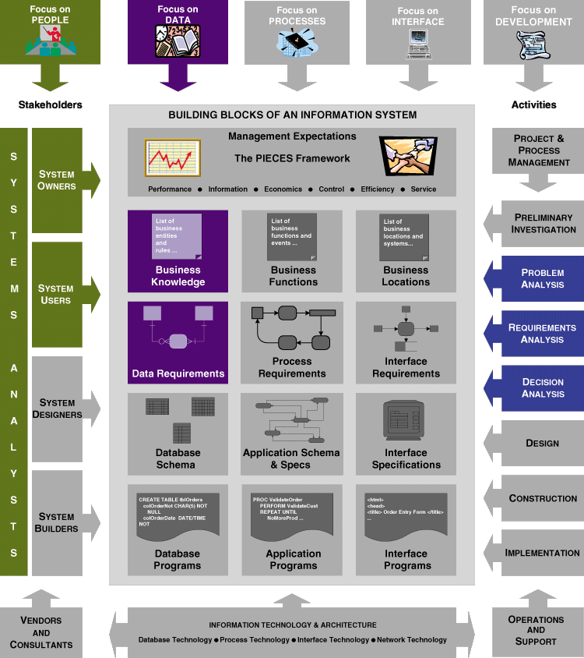
Chapter Map
Notes:
Chapter 7 - Data Modeling and Analysis
Teaching Notes
The emphasis of this chapter is upon the DATA. It also reflects the fact that data modeling may be performed during certain analysis phases and involves not only systems analysts…but owners and users.

Slide 4
System Models
A model is a representation of reality.
  Logical models
  Physical model
Logical models show what a system is or does. They are implementation independent; that is, they depict the system independent of any technical implementation.
Physical models show not only what a system is or does, but also how the system is physically and technically implemented.
Notes:
Chapter 7 - Data Modeling and Analysis
Teaching Tips:
While we do provide some subsequent slides that are examples of different types of models, you may obtain additional slides from chapters 7 and 8 to show them examples of logical data models and logical process models, and you may obtain additional slides from chapters 11-15 to show them examples of various physical models. Be sure to emphasis that the models represent or document technical implementations.

Slide 5
Data Modeling
Data modeling is a technique for organizing and documenting a system’s data.
Data modeling is sometimes called database modeling because a data model is eventually (finally) implemented as a database.
It is sometimes called information modeling.
The actual model is frequently called an entity relationship diagram (ERD) because it depicts data in terms of the entities and relationships described by the data.
Notes:
Chapter 7 - Data Modeling and Analysis
No additional notes

Slide 6
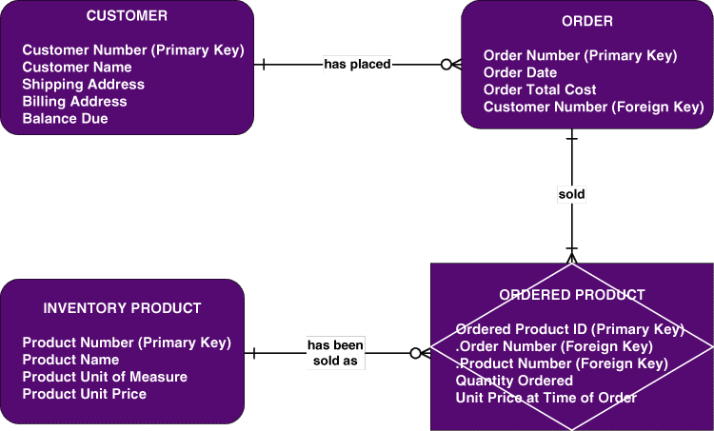
Sample Entity Relationship Diagram (ERD)
Notes:
Chapter 7 - Data Modeling and Analysis
Teaching Tips
Be sure to explain that this is merely an example –there are numerous data modeling notations. While they may differ in appearance (symbology) the knowledge that data models are intended to convey the same.

Slide 7
Data Modeling Concepts: Entity
An entity is a class of persons, places, objects, events, or concepts about which we need to capture and store data.
Name of Entity
Persons: agency, contractor, customer, department, division, employee, instructor, student, supplier.
Places: sales region, building, room, branch office, campus.
Objects: book, machine, part, product, raw material, software license, software package, tool, vehicle model, vehicle.
Events: application, award, cancellation, class, flight, invoice, order, registration, renewal, requisition, reservation, sale, trip.
Concepts: account, block of time, bond, course, fund, qualification, stock.
Notes:
Chapter 7 - Data Modeling and Analysis
Teaching Tips:
Prompt the students for additional examples. Have them classify their example(s).
Obtain a data model from a source other than the textbook. Ask the students to classify the entities.

Slide 8
Data Modeling Concepts: Entity
An entity instance is a single occurrence of an entity.
Example: instances of the entity STUDENT may include
Betty Arnold
John Taylor
Lisa Simmons
Bill Macy
Heather Leath
Tim Wrench
Notes:
Chapter 7 - Data Modeling and Analysis
Teaching Tips
Substitute the name(s) of one or more of your students.
Be sure to explain that these are “instances” and that instances do NOT appear in the names of entity symbols.

Slide 9
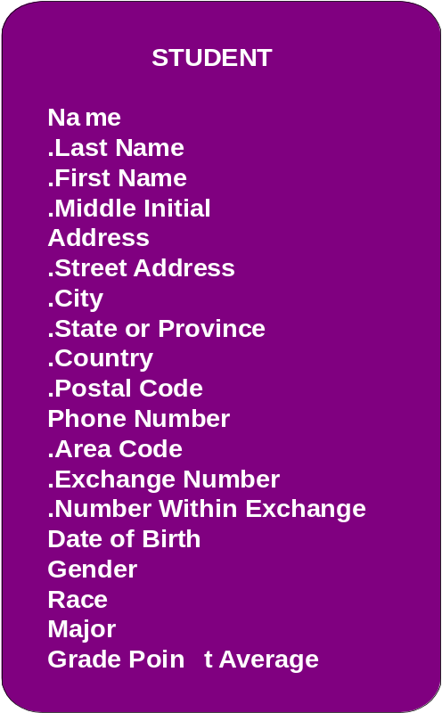
Data Modeling Concepts: Attributes
An attribute is a descriptive property or characteristic of an entity. Synonyms include element, property, and field.
A compound attribute is one that actually consists of other attributes
Notes:
Chapter 7 - Data Modeling and Analysis
Teaching Tips:
Show the students slide #6. Pick an entity and ask the students to list attributes that they feel describe those entities.
Show the students a form. Ask the students to identify the attributes. Be sure that the students recognize what items appearing on the form are truly attributes and those that are simply headings or preprinted items. Also, often times students accidentally identify attribute values as attributes. For example, they may say that an item that appears as a check box is an attribute when in fact it may be the value of an attribute (ie. Male and female are values, whereas GENDER is the real attribute).

Slide 10
Data Modeling Concepts: Domains
The data type for an attribute defines what type of data can be stored in that attribute.
The domain of an attribute defines what values an attribute can legitimately (legally) take on.
The default value for an attribute is the value that will be recorded if not specified by the user.
Notes:
Chapter 7 - Data Modeling and Analysis
No additional notes

Slide 11
Data Modeling Concepts: Identification
A key is an attribute, or a group of attributes, that assumes a unique value for each entity instance.
A group of attributes that uniquely identifies an instance of an entity is called a concatenated key.
A candidate key is a “candidate to become the primary key” of instances of an entity.
Notes:
Chapter 7 - Data Modeling and Analysis
No additional notes

Slide 12
Data Modeling Concepts: Identification
A primary key is that candidate key that will most commonly be used to uniquely identify a single entity instance.
Any candidate key that is not selected to become the primary key is called an alternate key.
A subsetting criteria is an attribute (or concatenated attribute) whose finite values divide all entity instances into useful subsets.
Notes:
Chapter 7 - Data Modeling and Analysis
No additional notes

Slide 13
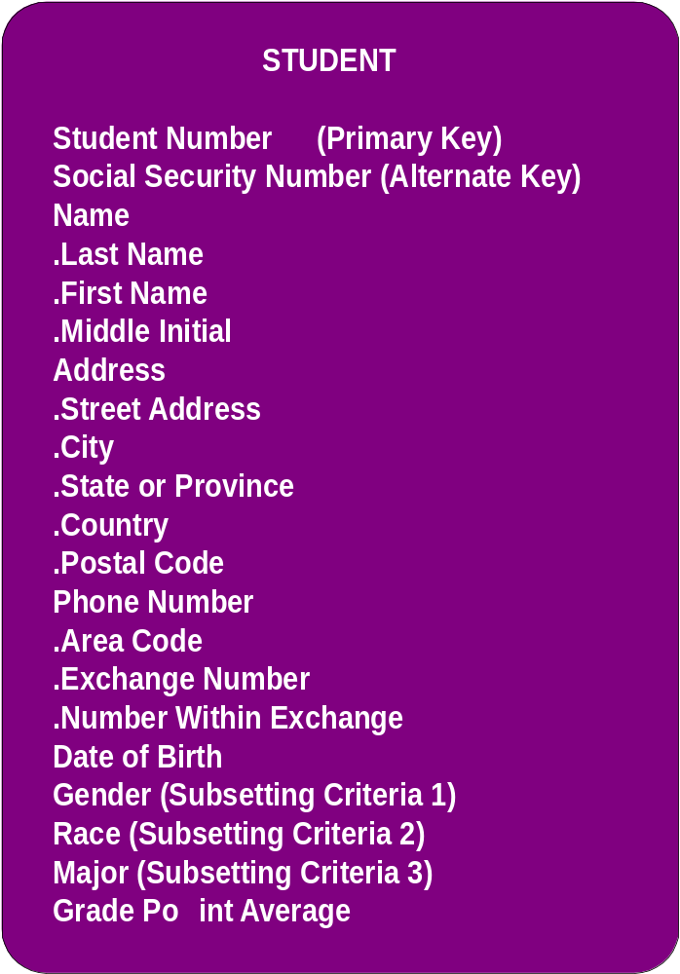
Data Modeling Concepts: Identification Keys & Subsetting Criteria
Race- jatigosthi
Notes:
Chapter 7 - Data Modeling and Analysis
No additional notes

Slide 14

Data Modeling Concepts: Relationships
A relationship is a natural business association that exists between one or more entities. The relationship may represent an event that links the entities or merely a logical affinity (similarity) that exists between the entities.
Notes:
Chapter 7 - Data Modeling and Analysis
Teaching Tips
Explain that there may be more than one relationship between two entities. You may reinforce this by adding additional relationships to the example (such as “transferred from” (to reflect a relationship where students changed from one curriculum to another).

Slide 15
Data Modeling Concepts: Cardinality
Cardinality defines the minimum and maximum number of occurrences of one entity that may be related to a single occurrence of the other entity.
Because all relationships are bidirectional, cardinality must be defined in both directions for every relationship.
bidirectional
Notes:
Chapter 7 - Data Modeling and Analysis
Teaching Tips
Ask the students to read (or write) declarative sentences to reflect the bidirectional meaning of the relationship between student and curriculum.

Slide 16
Data Modeling Concepts: Degree
The degree of a relationship is the number of entities that participate in the relationship.
Notes:
Chapter 7 - Data Modeling and Analysis
Teaching Tips:
Provide the students with an ERD that does not contain relationships. Ask the students to identify possible relationships and indicate a possible degree for that relationship.
Emphasize to the students that the degree represents a business rule! Failure to accurately identify and document the degree will result in a system that does not reflect a correct business requirement.

Slide 17
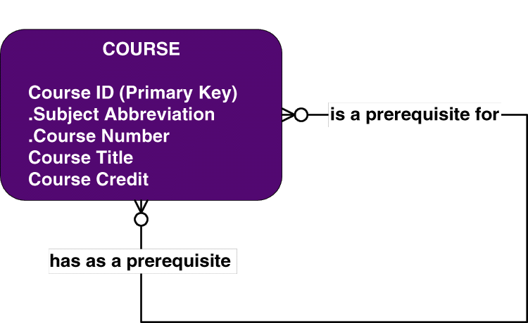
Data Modeling Concepts: Degree
A recursive relationship is a relationship that exists between different instances of the same entity
Notes:
Chapter 7 - Data Modeling and Analysis
Teaching Tips
Ask the students to read (or write) declarative sentences to reflect the bidirectional meaning of the relationship.
We created a composite key in this example. Be sure to point out the notation.

Slide 18
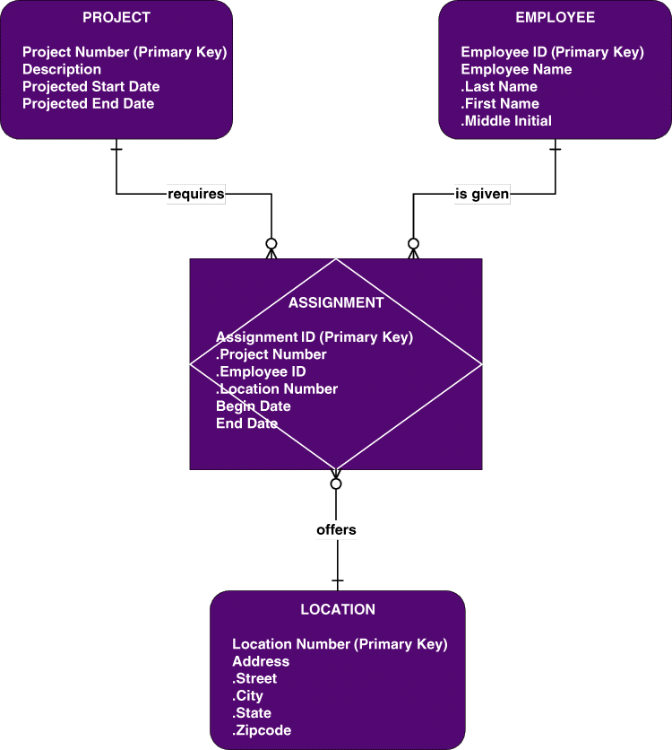
Data Modeling Concepts: Degree
Relationships may exist between more than two entities and are called N-ary relationships.
The example ERD depicts a ternary relationship.
Notes:
Chapter 7 - Data Modeling and Analysis
Teaching Tips
The example also depicts an associative entity for the first time…as explained on the next slide.

Slide 19
Data Modeling Concepts: Degree
An associative entity is an entity that inherits its primary key from more than one other entity (called parents).
Each part of that concatenated key points to one and only one instance of each of the connecting entities.
Notes:
Chapter 7 - Data Modeling and Analysis
No additional notes

Slide 20
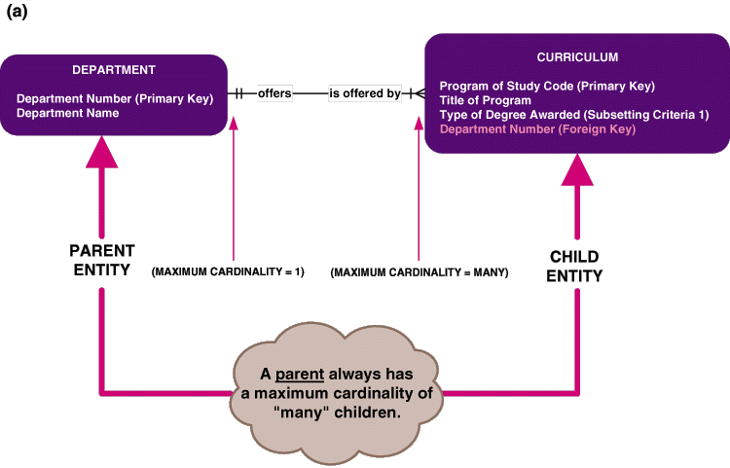
Data Modeling Concepts: Foreign Keys
A foreign key is a primary key of one entity that is contributed to (duplicated in) another entity to identify instances of a relationship.
Notes:
Chapter 7 - Data Modeling and Analysis
Teaching Tips
Additional examples should be given to test the student’s ability to recognize the parent entity. We suggest you also provide an example of a one-to-one relationship!

Slide 21
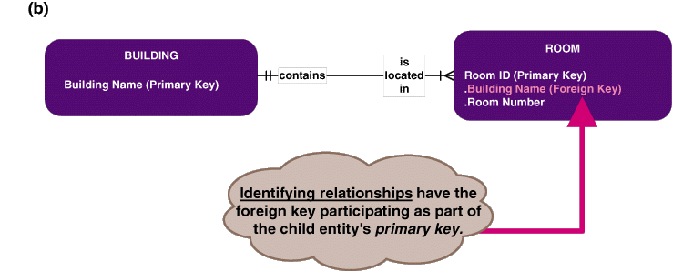
Data Modeling Concepts: Foreign Keys
Nonidentifying relationships are those in which each of the participating entities has its own independent primary key, In other words, none of the primary key attributes is shared.
Identifying relationships are those in which the parent entity contributes its primary key to become part of the primary key of the child entity.
Notes:
Chapter 7 - Data Modeling and Analysis
No additional notes

Slide 22
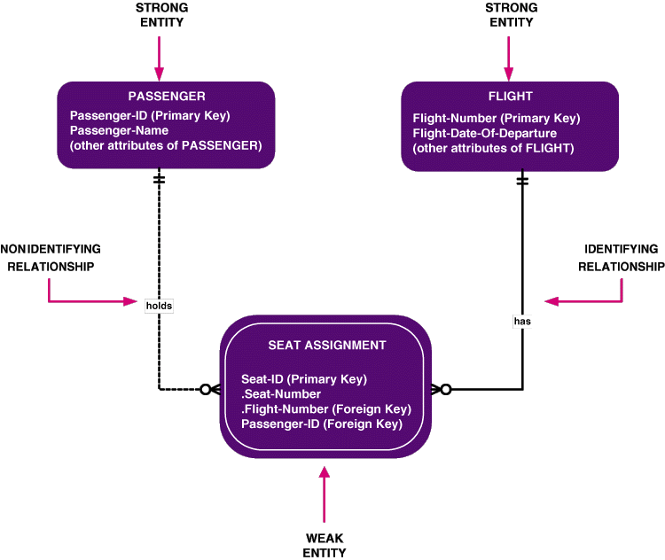
Data Modeling Concepts: Foreign Keys
Notes:
Chapter 7 - Data Modeling and Analysis
No additional notes

Slide 23
Data Modeling Concepts: Generalization
Generalization is a technique wherein the attributes that are common to several types of an entity are grouped into their own entity, called a supertype.
An entity supertype is an entity whose instances store attributes that are common to one or more entity subtypes.
An entity subtype is an entity whose instances inherit some common attributes from an entity supertype and then add other attributes that are unique to an instance of the subtype.
Notes:
Chapter 7 - Data Modeling and Analysis
Teaching Tips:
Ask the students to identify a generalization example. What are some common attributes? What are some unique attributes associated with the subtype(s)?

Slide 24
The Key-based Data Model
sells
MEMBER ORDER
is a
Primary Key
Order-Number [PK1]
MEMBER ORDERED PRODUCT
responds
Primary Key
to
MEMBER
Order-Number [PK1] [FK]
places
Primary Key
Product-Number [PK2] [FK]
Member-Number [PK1]
has
conducted
sold as
PRODUCT
generates
binds
Primary Key
TRANSACTION
Product-Number [PK1]
Primary Key
Transaction-Reference-Number [PK1]
is featured as
AGREEMENT
Primary Key
Agreement-Number [PK1]
TITLE PROMOTION
PROMOTION
Primary Key
features
Primary Key
Product-Number [PK1] [FK]
Promotion-Number [PK1]
Promotion-Number [PK2] [FK]
Notes:
Chapter 7 - Data Modeling and Analysis
Edit this slide as needed to ensure readability.

Slide 25
The Key-based Data Model With Generalization
sells
MEMBER ORDER
is a
Primary Key
Order-Number [PK1]
responds
to
MEMBER ORDERED PRODUCT
Primary Key
has
Order-Number [PK1] [FK]
MEMBER
conducted
Product-Number [PK2] [FK]
places
Primary Key
Member-Number [PK1]
sold as
binds
TRANSACTION
Primary Key
Transaction-Reference-Number [PK1]
AGREEMENT
Primary Key
Agreement-Number [PK1]
PRODUCT
Primary Key
Product-Number [PK1]
generates
PROMOTION
Primary Key
is a
is a
Promotion-Number [PK1]
MERCHANDISE
TITLE
Primary Key
Primary Key
Product-Number [PK1] [FK]
Product-Number [PK1] [FK]
is featured as
PROMOTION TITLE
features
is a
is a
is a
Primary Key
Promotion-Number [PK1] [FK]
Product-Number [PK2] [FK]
AUDIO TITLE
VIDEO TITLE
GAME TITLE
Primary Key
Primary Key
Primary Key
Product-Number [PK1] [FK]
Product-Number [PK1] [FK]
Product-Number [PK1] [FK]
Notes:
Chapter 7 - Data Modeling and Analysis
Edit this slide as needed to ensure readability.

Slide 26
The Fully-Attributed Data Model
MEMBER ORDER
Primary Key
Order-Number [PK1]
Non-Key Attributes
Order-Creation-Date
is a
Order-Fill-Date
Member-Name
Member-Address
sells
Shipping-Address-Name
Shipping-Street-Address
MEMBER
Shipping-City
Primary Key
Shipping-State
Member-Number [PK1]
Shipping-Zip
Non-Key Attributes
Shipping-Instructions
Member-Name
has
Order-Sub-Total
Member-Status
conducted
MEMBER ORDERED PRODUCT
Order-Sales-Tax
Member-Street-Address
Primary Key
Order-Shipping-Method
responds
Member-Post-Office-Box
Order-Shipping-&-Handling-Cost
to
Member-City
Order-Number [PK1] [FK]
Order-Status
Member-State
Product-Number [PK2] [FK]
Order-Prepaid-Amount
Member-Zip-Code
Order-Prepayment-Method
Member-Daytime-Phone-Number
Promotion-Number [FK]
Member-Date-of-Last-Order
TRANSACTION
Member-Number [FK]
Member-Balance-Due
Member-Number-1 . Member-Number [FK]
Member-Credit-Card-Type
Primary Key
Ordered-Product-Number
Member-Credit-Card-Number
Transaction-Reference-Number [PK1]
Quantity-Shipped
places
Member-Credit-Card-Expire-Date
Non-Key Attributes
Quantity-Backordered
Member-Bonus-Balance-Available
Transaction-Date
Ordered-Product-Description
Audio-Category-Preference
Transaction-Type
Ordered-Product-Title
Audio-Media-Preference
Transaction-Description
sold as
Purchased-Unit-Price
Date-Enrolled
Transaction-Amount
Extended-Price
Expiration-Date
Member-Number [FK]
Game-Category-Preference
Order-Number [FK]
Game-Media-Preference
Number-of-Credits-Earned
Video-Category-Preference
Video-Media-Preference
Agreement-Number [FK]
Privacy-Code
Email-Address
PRODUCT
Primary Key
Product-Number [PK1]
Non-Key Attributes
AGREEMENT
"Universal-Product-Code (Alternate Key)"
Quantity-in-Stock
Primary Key
Product-Type
Agreement-Number [PK1]
Suggested-Retail-Price
Non-Key Attributes
Default-Unit-Price
binds
Agreement-Expire-Date
Current-Special-Unit-Price
Agreement-Active-Date
Current-Month-Units-Sold
Fulfillment-Period
Current-Year-Units-Sold
Required-Number-of-Credits
Total-Lifetime-Units-Sold
is a
is a
MERCHANDISE
TITLE
generates
PROMOTION
Primary Key
Primary Key
Primary Key
Product-Number [PK1] [FK]
Product-Number [PK1] [FK]
Promotion-Number [PK1]
Non-Key Attributes
Non-Key Attributes
Non-Key Attributes
Merchandise-Name
Title-of-Work
Promotion-Release-Date
Merchandise-Description
Title-Cover
Promotion-Status
Merchandise-Type
Catalog-Description
is featured as
Promotion-Type
Unit-of-Measure
Copyright-Date
Product-Number
Entertainment-Category
Title-of-Work
Credit-Value
TITLE PROMOTION
Primary Key
Promotion-Number [PK1] [FK]
features
is a
is a
is a
Product-Number [PK2] [FK]
AUDIO TITLE
VIDEO TITLE
GAME TITLE
Primary Key
Primary Key
Primary Key
Product-Number [PK1] [FK]
Product-Number [PK1] [FK]
Product-Number [PK1] [FK]
Non-Key Attributes
Non-Key Attributes
Non-Key Attributes
Artist
Producer
Manufacturer
Audio-Category
Director
Game-Category
Audio-Sub-Category
Video-Category
Game-Sub-Category
Number-of-Units-in-Package
Video-Sub-Category
Game-Platform
Audio-Media-Code
Closed-Captioned
Game-Media-Type
Content-Advisory-Code
Language
Number-of-Players
Running-Time
Parent-Advisory-Code
Video-Media-Type
Video-Encoding
Screen-Aspect
MPA-Rating-Code
Notes:
Chapter 7 - Data Modeling and Analysis
Edit this slide as needed to ensure readability.

